Slide 1
VCU’s Employee Giving Campaign
April 3, 2018

Slide 2
Purpose
This campaign is an initiative to promote philanthropy among faculty, staff, retirees, team members and caregivers of VCU and VCU Health.
Giving back is an opportunity for employees to say “I BELIEVE” in VCU and VCU Health.
Participation from dedicated employees demonstrates that the university is one of the best investments for a potential donor’s philanthropic support.
When we give, we inspire others to give.

Slide 3
The official employee giving campaign at VCU is entering its third year.
The campaign drive runs April 2-May 16.
The goal is participation: As many employees giving any amount.
In fiscal year 2017, employees (1,636 donors) exceeded expectations by donating 3.2% more revenue than in FY16.

Slide 4
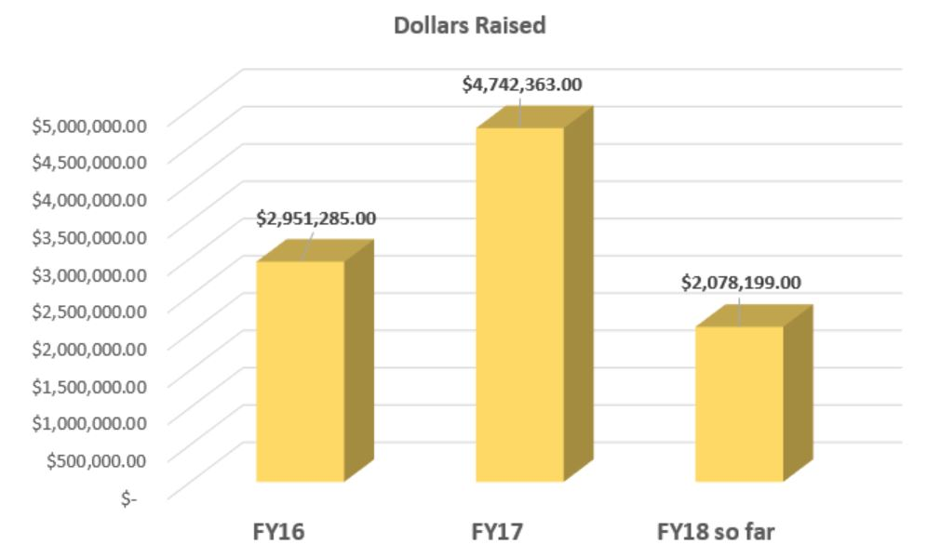
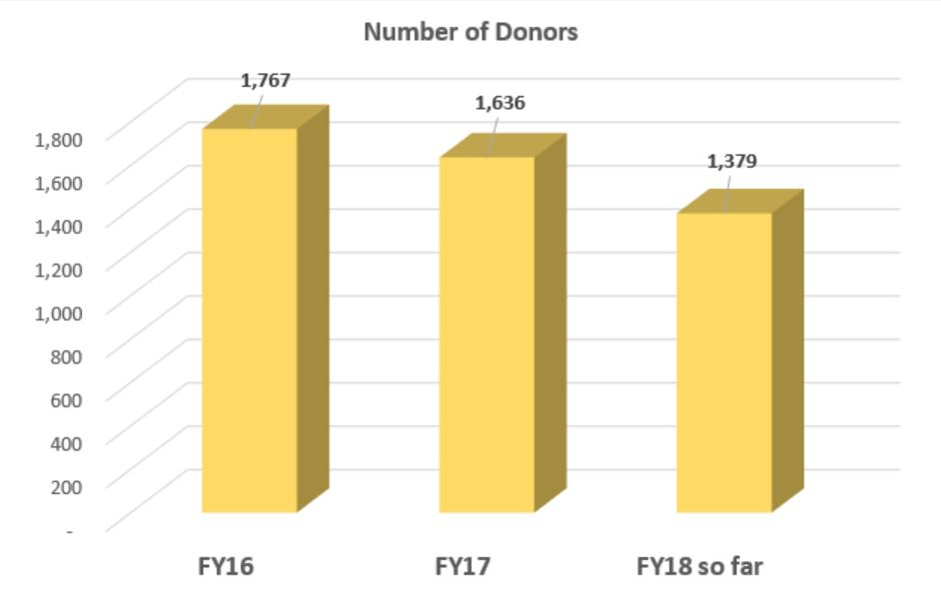
Overall results FY16 - FY18

Slide 5
Key facts
Every gift matters to the university, no matter the dollar amount or the designation. The campaign’s success is primarily focused on participation, making it possible for every single employee to be a part of the effort.
Did you know?
1,636 employees and retirees of VCU and VCU Health made a gift to support VCU in FY17.
There are over 800 funds to select from when supporting VCU or VCU Health.
Employees systemwide gave $4,742,363 to support VCU and VCU Health collectively.
All private gifts of less than $100 raised more than $1 million to support VCU and VCU Health.
If half of the VCU and VCU Health workforce (22,473 employees) made a payroll deduction donation of just $4.16 per pay period, an additional $1,123,650 would be donated to support the university and VCU Health annually.
The Faculty Senate has a 20% giving rate as of this morning.

Slide 6
Website: support.vcu.edu/faculty
VCU Payroll deduction: support.vcu.edu/facultystaff/payrolldeduction
VCU Health Payroll deduction: support.vcu.edu/give/payroll/vcuhealth
Online giving: support.vcu.edu/give
Contacts:
Mike Andrews (M.S.’05/E), executive director of annual giving, andrewsmp@vcu.edu, (804) 828-0236
Rich Spain (M.S.’13/E), leadership engagement officer, spainrt@vcu.edu, (804) 828-6502

